Slide 1
Planting Hope

Slide 2
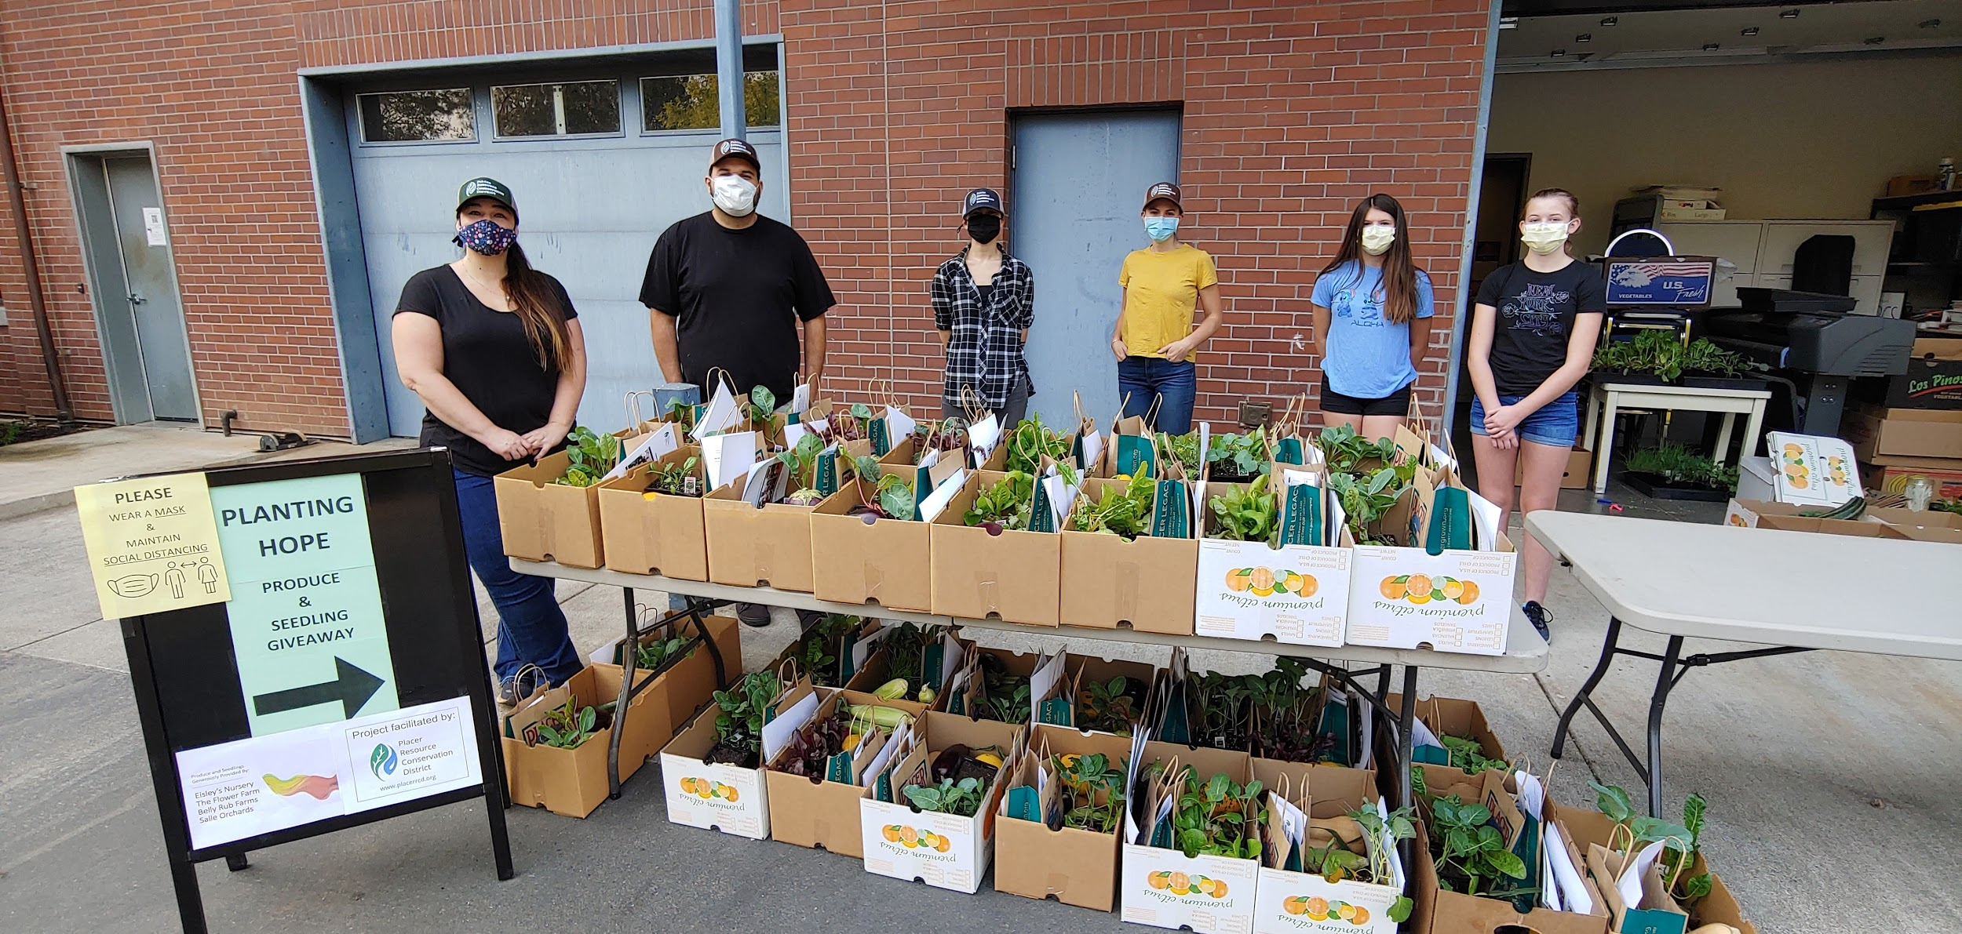
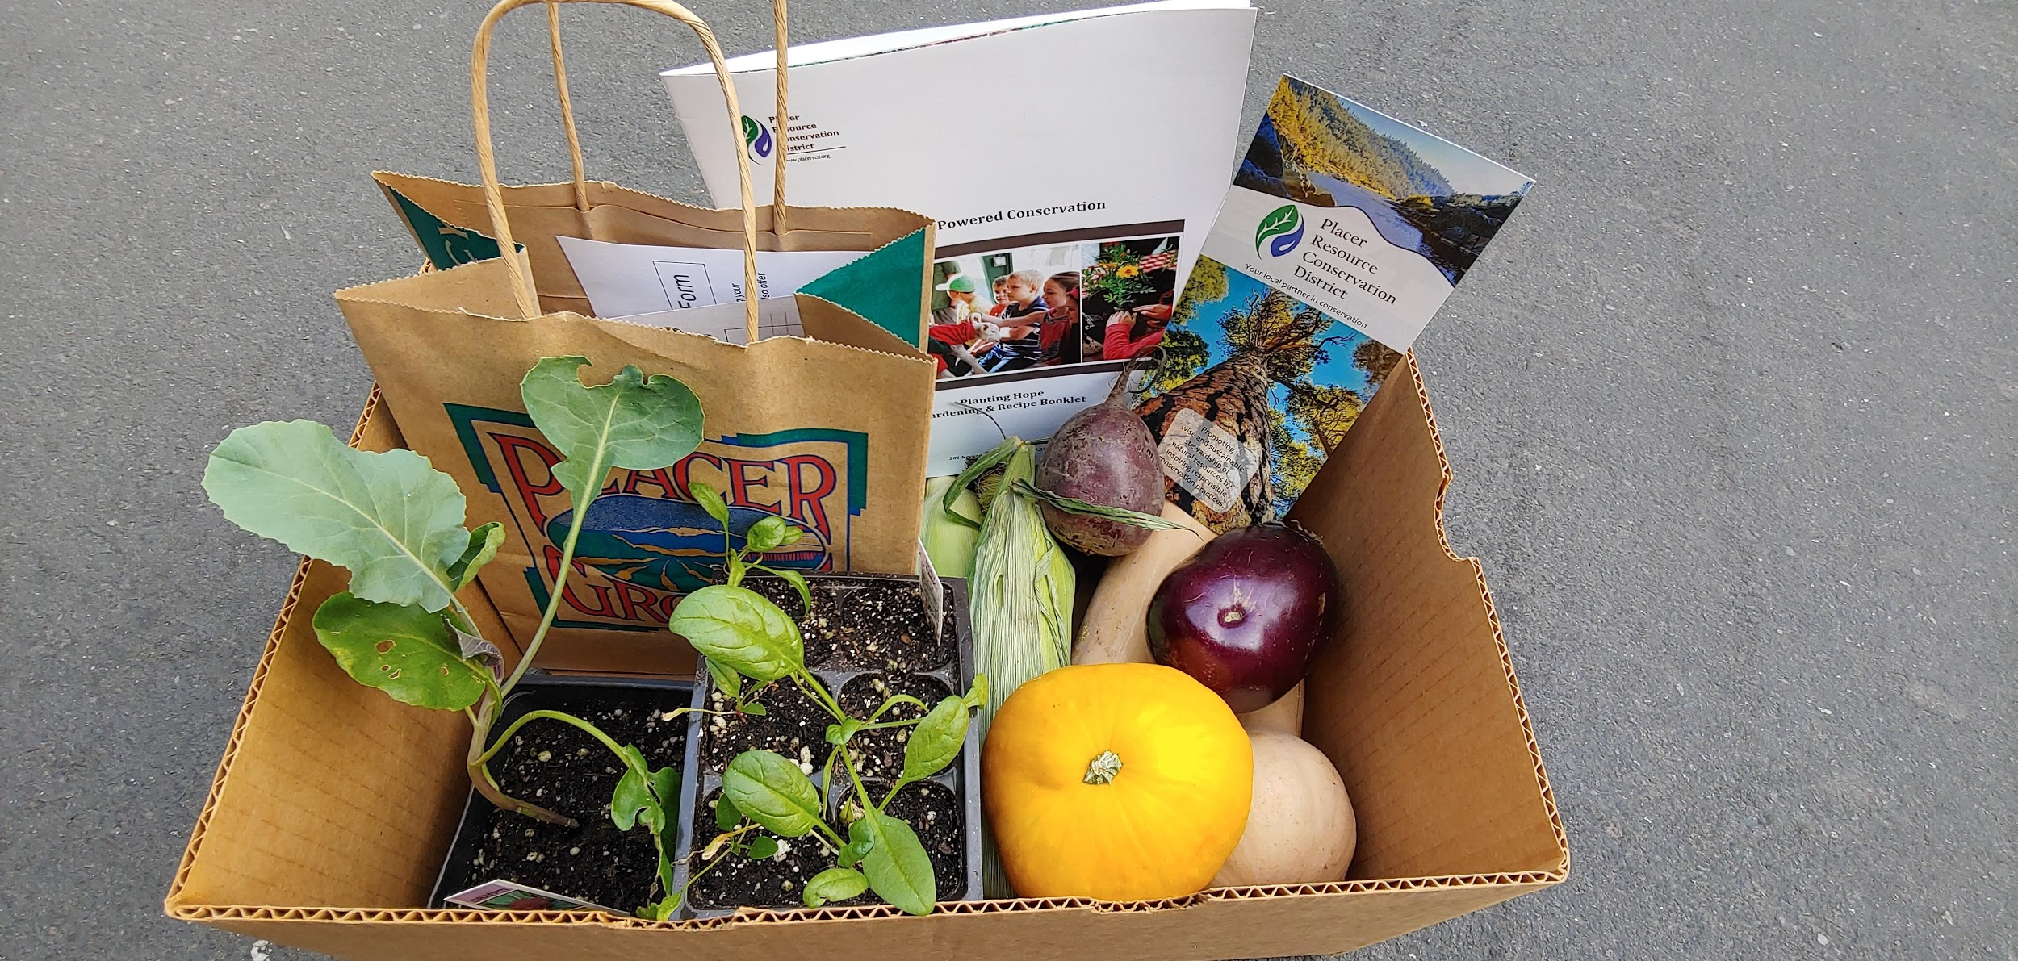
Objectives:
Alleviate food insecurity resulting from the COVID-19 pandemic
Provide opportunities for hands-on learning
Empower community members with the tools for successful planting

Slide 3
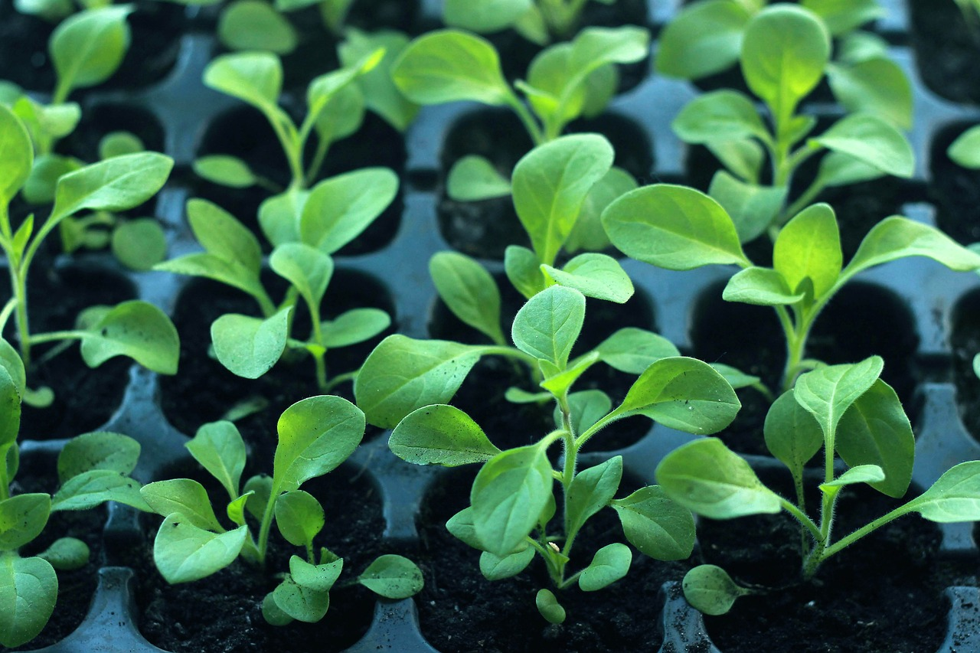
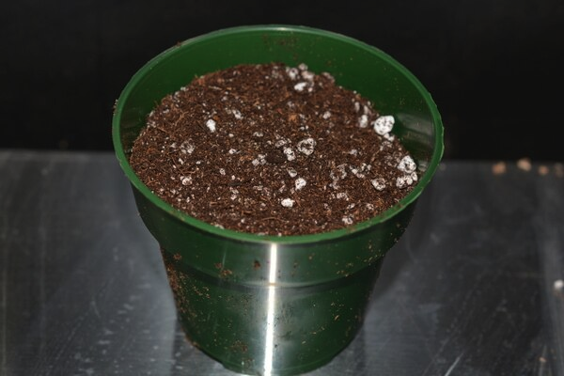
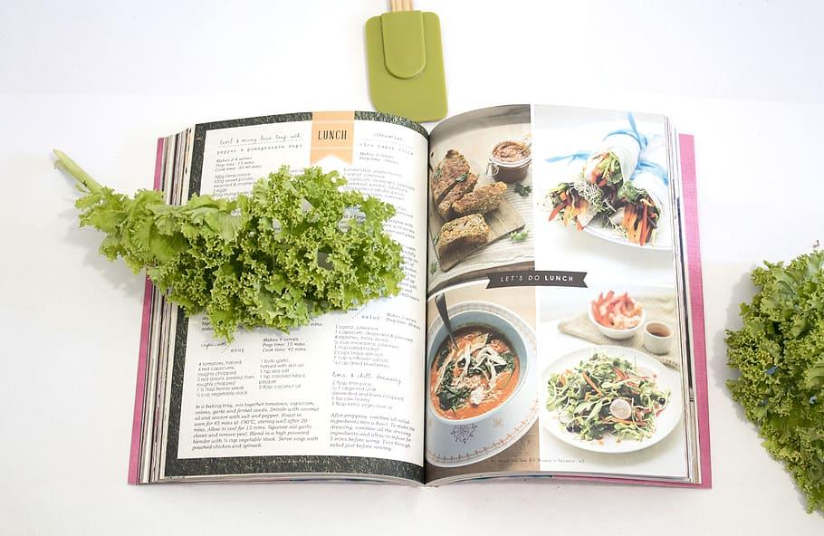
Staff and Volunteers assembled Planting Hope Kits
150 Vegetable Seedlings
Nearly 300 lbs of produce
Small Starter Pot with Soil
Planting Guide & Recipe Booklet
Notes:
NOTES:
Seedlings included: leafy greens like lettuce, spinach, and chard; cauliflower, brussels sprouts, and beets
Produce included: kale, eggplants, squash, garlic, zucchini, tomatoes, pears, beets, and corn
Booklets included: transplanting guide, advice on cost-effective garden beds, instructions for how to prepare butternut squash and beets, and a series of recipes including butternut squash mac and cheese and zucchini bread.
52 kits made

Slide 4
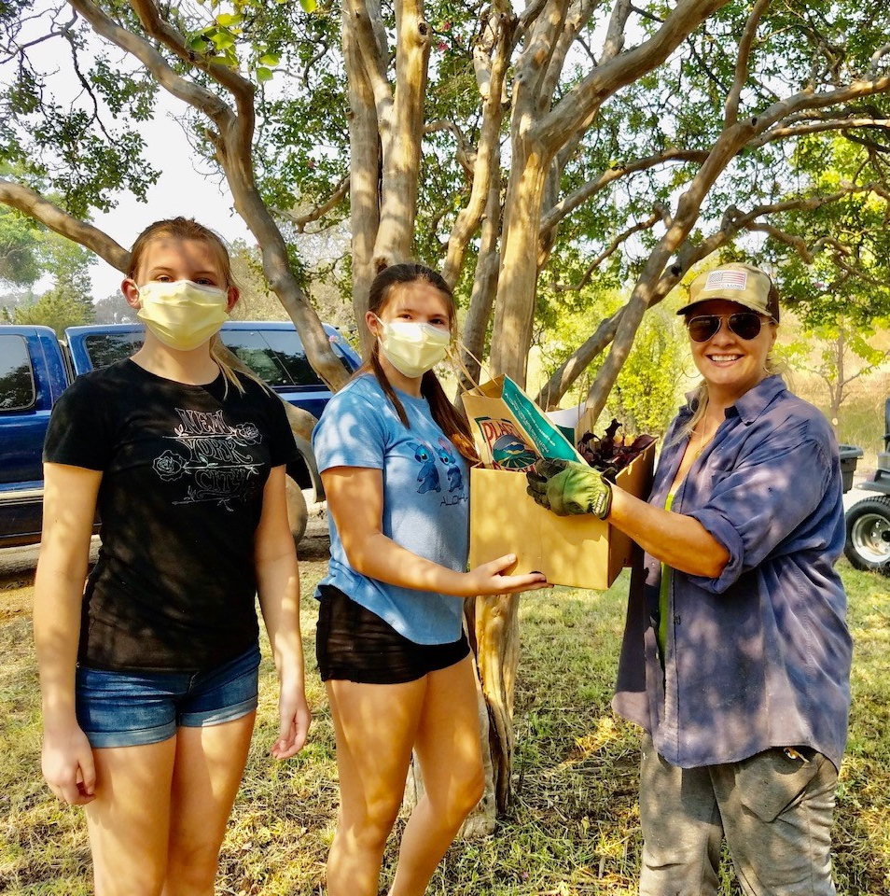
Outcomes:
Hosted Planting Hope curbside pickup event
Dozens of Planting Hope Kits donated
Leftover produce was donated to the Auburn Interfaith Food Closet
Remaining seedlings were donated to Foresthill High School for use in their environmental education community garden
News releases published with Gold Country Media, Newsbreak, NRCS state e-newsletter, and NACD

Slide 5
Thank you!
Thank you to our local farms and nursery:
The Flower Farm, Loomis
Belly Rub Farms, Loomis
Laughing Duck Farms, Newcastle
Salle Orchards, Wheatland
Eisley’s Nursery, Auburn
Thank you to the Placer RCD staff and volunteers that helped make the event a success.
Special thanks to CARCD for providing the grant funds.
Notes:
NOTES:
Seedlings included: leafy greens like lettuce, spinach, and chard; cauliflower, brussels sprouts, and beets
Produce included: kale, eggplants, squash, garlic, zucchini, tomatoes, pears, beets, and corn
Booklets included: transplanting guide, advice on cost-effective garden beds, instructions for how to prepare butternut squash and beets, and a series of recipes including butternut squash mac and cheese and zucchini bread.
Volunteers even delivered 10 kits to a nearby elderly mobile home park in Newcastle (that’s where photo was taken from, in case anybody asks)

